Slide 1

Welcome to StoryVerse
Introducing StoryVerse: Reimagine interactive storytelling. Empower creators and engage audiences through choice.
Over $2.3 billion invested in interactive fiction in 2023 shaping the future of narratives.
Name - Maniya Motiramani

Slide 2
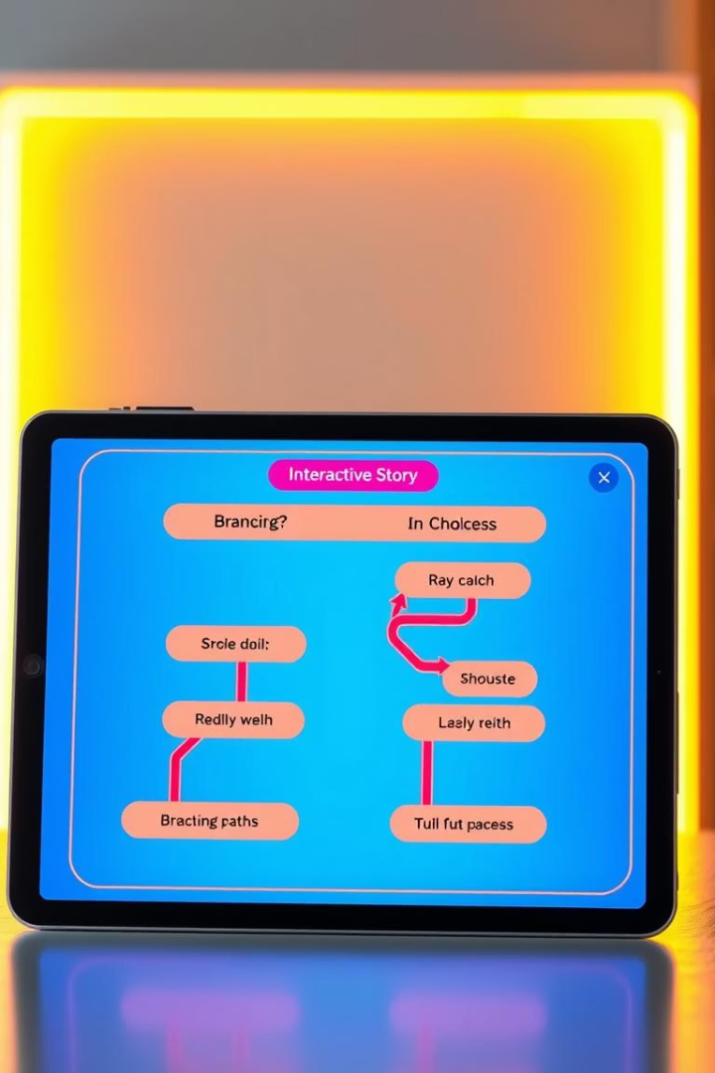
Key Features: Choice-Driven Narratives
Branching Storylines
Real-Time Consequences
User decisions shape unique story paths and endings.
Choices impact plot and character development instantly.
Higher Engagement
70% more engagement versus traditional media formats.

Slide 3
How StoryVerse Works: Empowering Creators
Intuitive Interface
Script Automation
Revenue Sharing
Drag-and-drop tools simplify story creation effortlessly.
Auto branching speeds up writing complex scripts.
Creators keep 60% earnings; platform retains 40%.

Slide 4

Benefit 1: Deep Audience Engagement
Personalized Experience
Stories adapt to user preferences for deeper connection.
Data Insights
Analytics help creators optimize storytelling content.
User Retention
Average session time is 45 minutes per user.
Completion Rates
90% of users finish interactive stories fully.

Slide 5

Benefit 2: New Revenue Streams
Monetization Methods
Premium Content
Subscriptions, in-app purchases, and advertising options.
Unlock exclusive story chapters and special experiences.
Creator Earnings
Top creators earn up to $10,000 monthly.

Slide 6
Benefit 3: Community and Collaboration
Vibrant Community
Co-Creation
Published Stories
Connect with over 20,000 active creators and fans.
Receive audience feedback to collaboratively evolve stories.
More than 5,000 interactive stories available today.

Slide 7




Future of StoryVerse: Expansion and Innovation
VR/AR Integration
Create immersive and sensory-rich narratives.
AI Story Generation
Personalized tales crafted with advanced AI technology.
Blockchain Ownership
Secure and monetize creative content seamlessly.

Slide 8

Summary: Join the StoryVerse Revolution
Future is Interactive
Storytelling is evolving with engagement and choice.
Empower Creators
Unlock potential with tools and community support.
Start Creating
Visit StoryVerse.com and bring your stories to life.

